Slide 1
Title
slide # (for organizer use only), presenter name
Text or image (no animation or video)
Text or image (no animation or video)
next slide #, next presenter name (for organizer use only)

Slide 2
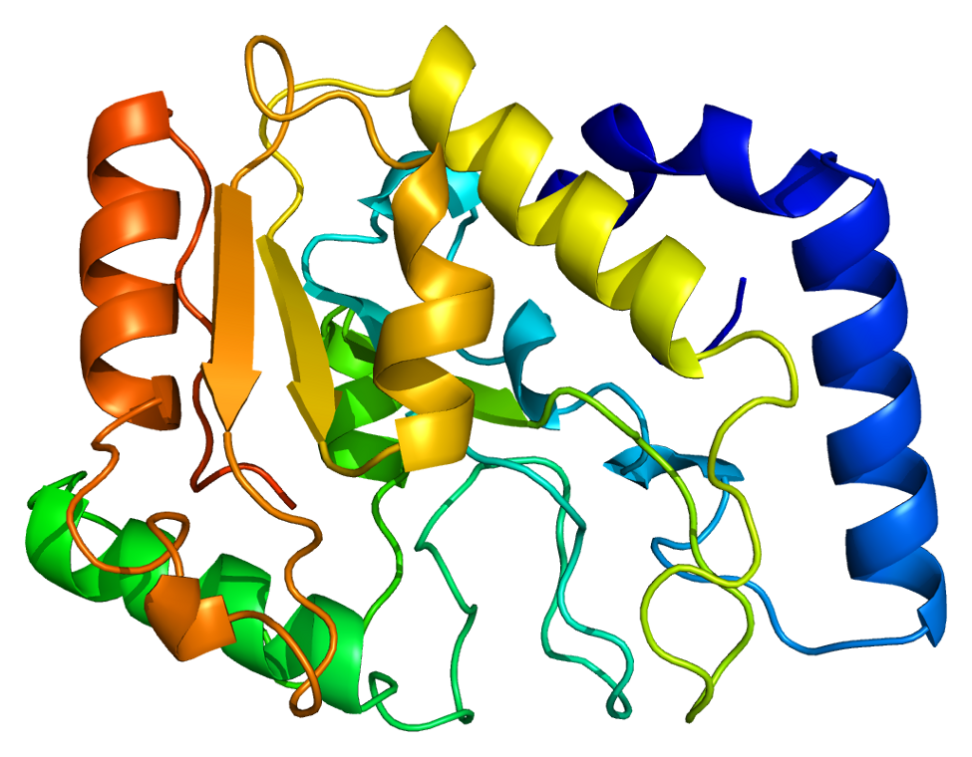
Excision of oxidatively damaged bases in G-quadruplexes by the DNA glycosylases NEIL1 and NEIL3
slide # (for organizer use only), Savannah G. Conlon
DNA damage
environmental toxins
endogenous metabolic products
ionizing radiation
Reactive oxygen and nitrogen species (RONS)
Example Slide
next slide #, next presenter name (for organizer use only)

